Slide 1
Adding Conditional Control to Text-to-Image Diffusion Models
Lvmin Zhang, Anyi Rao, Maneesh Agrawala, “Adding Conditional Control to Text-to-Image Diffusion Models”, in Proc. the IEEE/CVF Conference on Computer Vision and Pattern Recognition (CVPR), 2024. Available: https://arxiv.org/abs/2302.05543
2025-03-25
Sein Choi
Intelligent Vision Processing Lab. (IVPL)
https://ivpl.sookmyung.ac.kr
Div. of AI Engineering, Sookmyung Women’s University
E-mail: csi1806@sookmyung.ac.kr

Slide 2
No. | Title | Keyword | Cite
1 | Learning Transferable Visual Models From Natural Language Supervision | Contrastive Learning, Multimodal Representation | Alec Radford, Jong Wook Kim. (2021). Learning Transferable Visual Models From Natural Language Supervision, In Proc. of the 38th International Conference on Machine Learning, pages 8748–8763. PMLR. [Online]. Available: https://arxiv.org/abs/2103.00020
2 | GLIDE: Towards photorealistic image generation and editing with text-guided diffusion models | Text-to-Image Generation, Diffusion Models, guided image synthesis | A Nichol, P. Dhariwal, A. Ramesh. “GLIDE: Towards photorealistic image generation and editing with text-guided diffusion models”, In Proc. of the 39th International Conference on Machine Learning, 2022, pp. 16907-16921. Available: https://arxiv.org/abs/2112.10741
3 | Hierarchical Text-Conditional Image Generation with CLIP Latents | Text-to-Image Generation, CLIP Latents, unCLIP, Diffusion Models | Ramesh A, Dhariwal P, Nichol A, Chu C, Chen M., “Hierarchical Text-Conditional Image Generation with CLIP Latents”, 2022, Available: https://arxiv.org/abs/2112.10741
4 | High-Resolution Image Synthesis with Latent Diffusion Models | Text-to-Image Generation, VAE, Diffusion Models, Cross-Attention | Rombach, R., Blattmann, A., Lorenz, D., Esser, P., & Ommer, B.,"High-Resolution Image Synthesis with Latent Diffusion Models," in Proc. the IEEE/CVF Conference on Computer Vision and Pattern Recognition (CVPR), 2022. Available: https://arxiv.org/abs/2112.10752
5 | SDXL: Improving Latent Diffusion Models for High-Resolution Image Synthesis | LDM | D. Podell, Z. English, K. Lacey, A. Blattmann, T. Dockhorn, J. Müller, J. Penna, and R. Rombach, "SDXL: Improving Latent Diffusion Models for High-Resolution Image Synthesis,“, in Proc. the IEEE/CVF Conference on Computer Vision and Pattern Recognition (CVPR), 2023. Available: https://arxiv.org/abs/2307.01952.
6 | Adding Conditional Control to Text-to-Image Diffusion Models | Stable Diffusion, zero convolution, trainable copy | Lvmin Zhang, Anyi Rao, Maneesh Agrawala, “Adding Conditional Control to Text-to-Image Diffusion Models”, in Proc. the IEEE/CVF Conference on Computer Vision and Pattern Recognition (CVPR), 2024. Available: https://arxiv.org/abs/2302.05543

Slide 3
Contents
Introduction
ControlNet
Ablation Study
Training
Evaluation & Conclusion

Slide 4
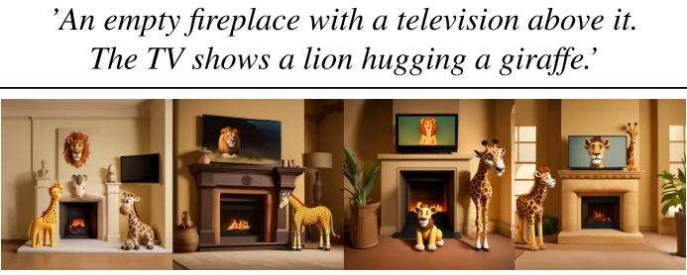
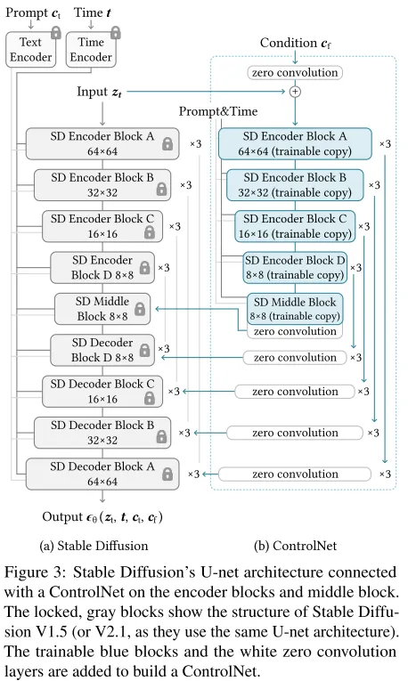
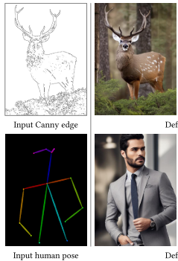
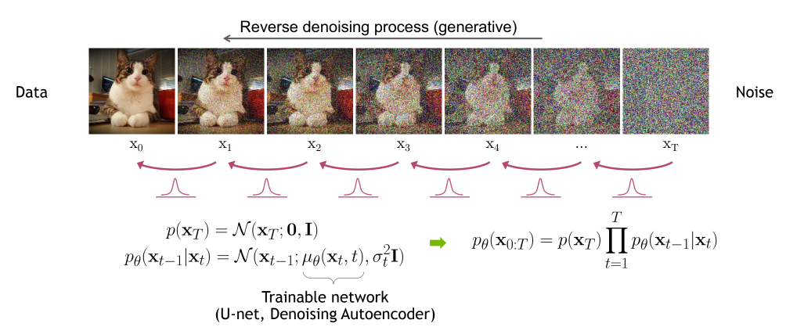
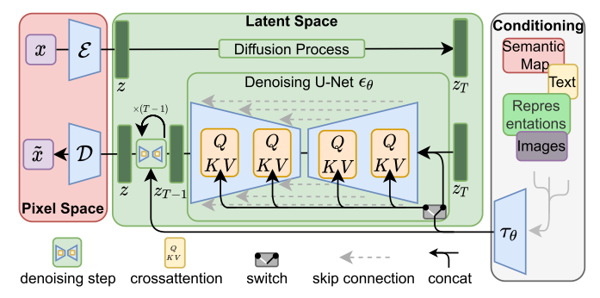
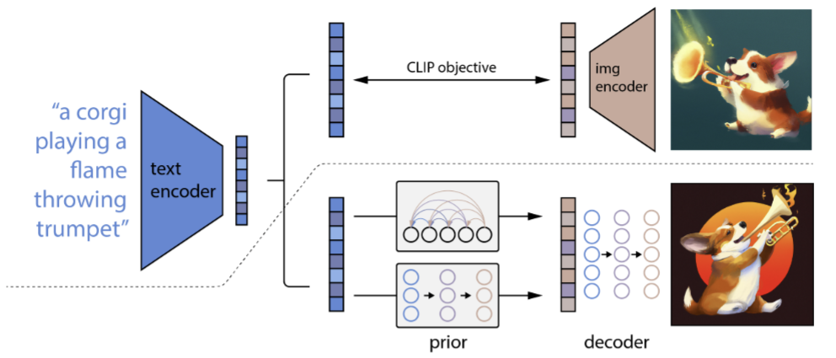
Introduction
The limitations of T2I models: Limited control over the spatial composition of images
Need for finer-grained spatial control, So adding a conditioning image
Model learns how to match the conditioning to target image
Finetuning Large pretrained moel cause overfitting or catastrophic forgetting
So propose ControlNet; end-to-end network that learns conditional control for large pretrained T2I diffusion models (such as Stable Diffusion)
SDXL Limitations
DDPM/DDIM
LDM (T2I w. extra Conditioning)
DALL-E2 (T2I)
ControlNet

Slide 5
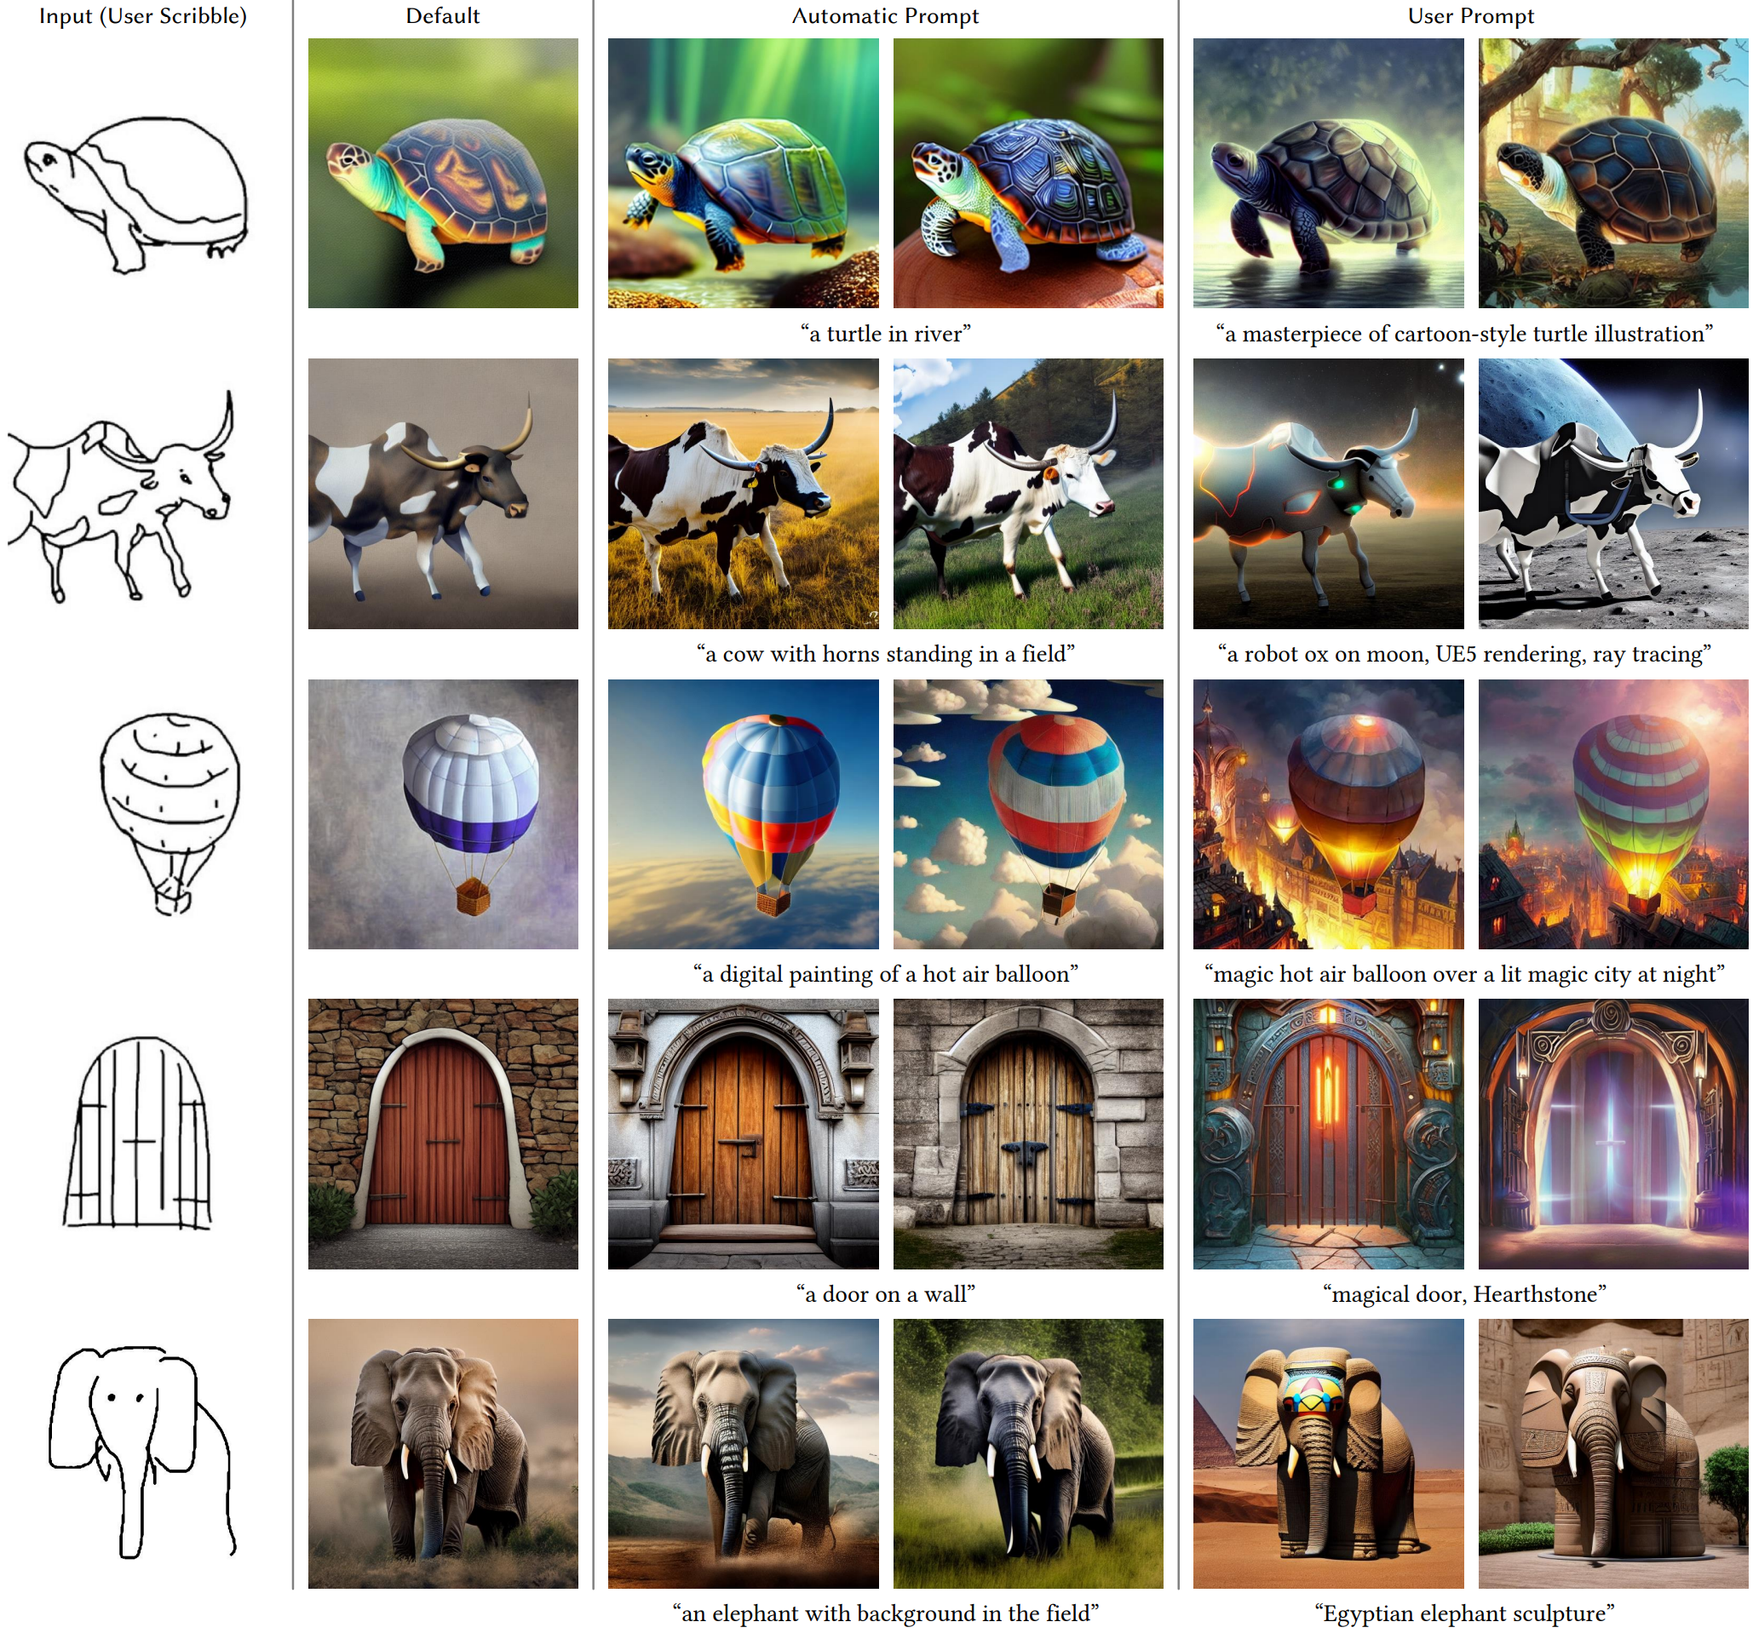
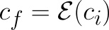
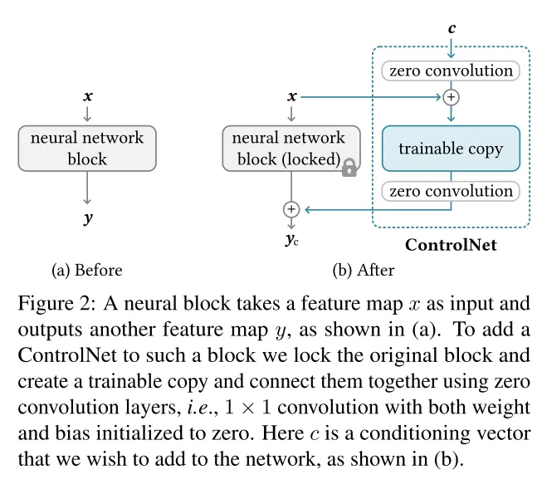
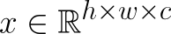
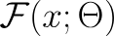
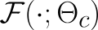
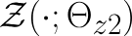
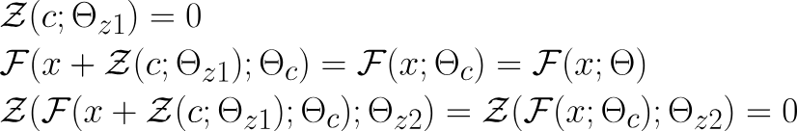
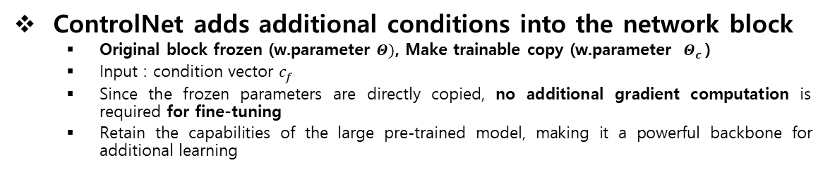
ControlNet
positional encoding
ControlNet adds additional conditions into the network block
Original block frozen (w.parameter $Θ)$, Make trainable copy (w.parameter $Θ_{c}$)
Input : condition vector $c_{f}$
Since the frozen parameters are directly copied, no additional gradient computation is required for fine-tuning
Retain the capabilities of the large pre-trained model, making it a powerful backbone for additional learning
OenAI CLIP
512x512
64x64 feature map
(4 ResNet + 2 ViTs)
2D Feature map
2D Feature map
zero-convolution
Trick to stabilize training w. trainable copy
Zero-convolution protect harm random noise during the initial training phase, protecting this backbone.
1x1 Contolution Layer
weight : 0
bias : 0
Q. Why they didn’t add trainable copy in Decoder?

Slide 6
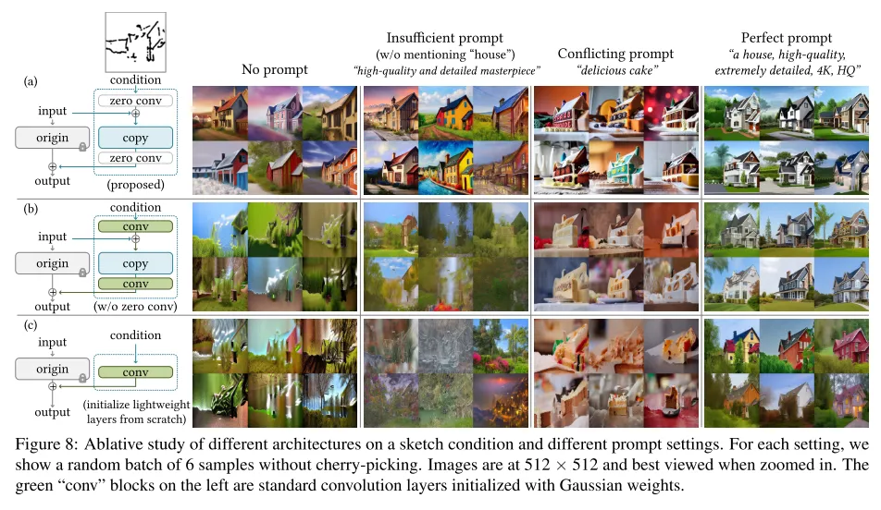
Ablation Study
ControlNet works effectively in all prompt settings
Demonstrating the structural effectiveness of zero convolution
ControlNet
zero conv
-> gaussian conv
ContolNet-lite

Slide 7
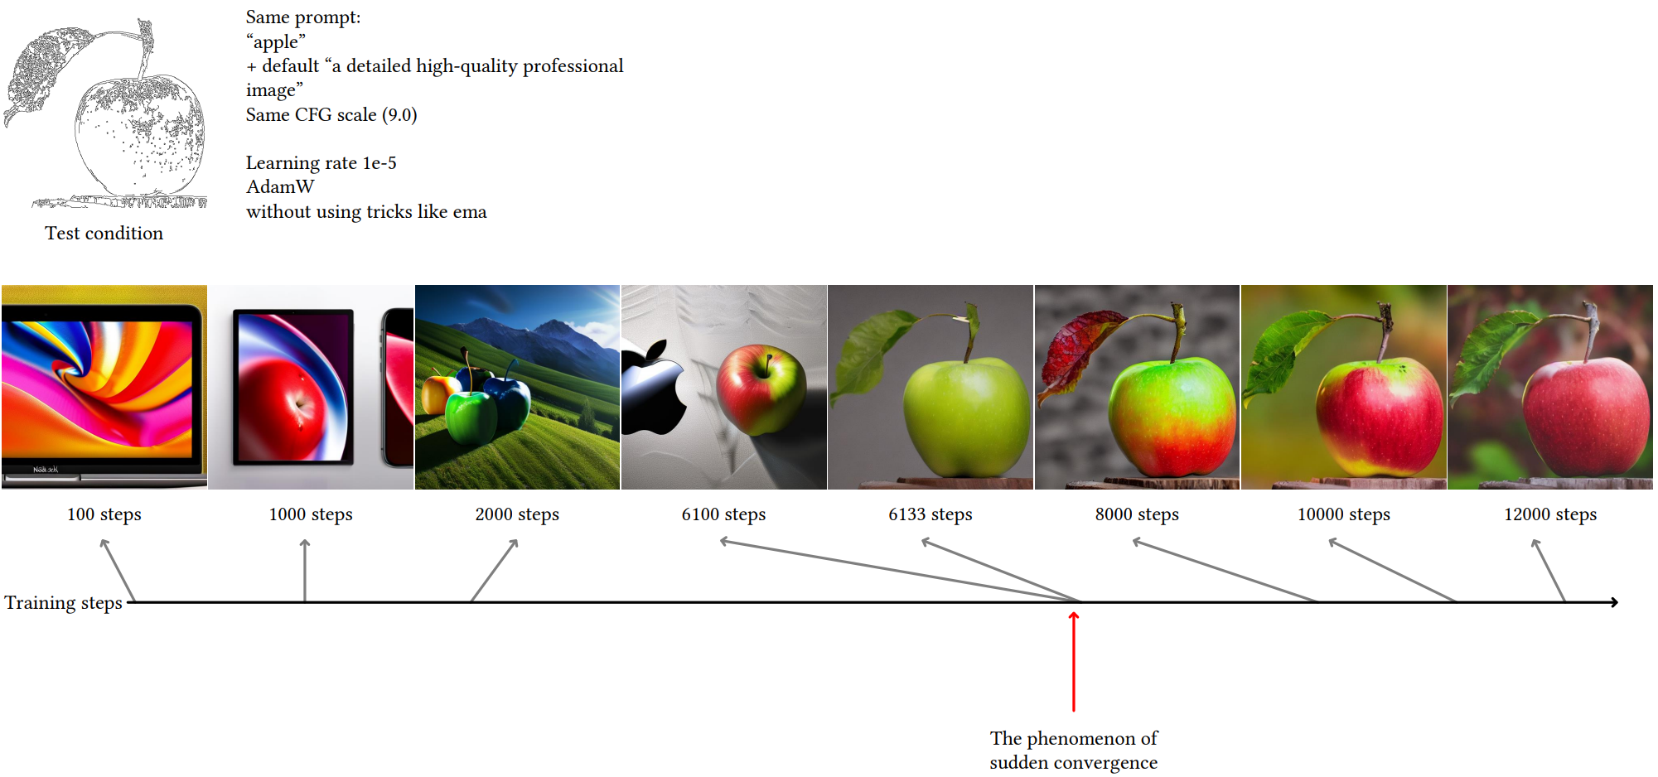
Training
Loss Function (Learning objective)
50% Empty string of Text Prompt
Increased Model's Semantic Recognition Ability
Sudden convergence phenomenon
Training Resource
20,000 training samples, single Nvidia RTX 3090Ti for 5 Days

Slide 8
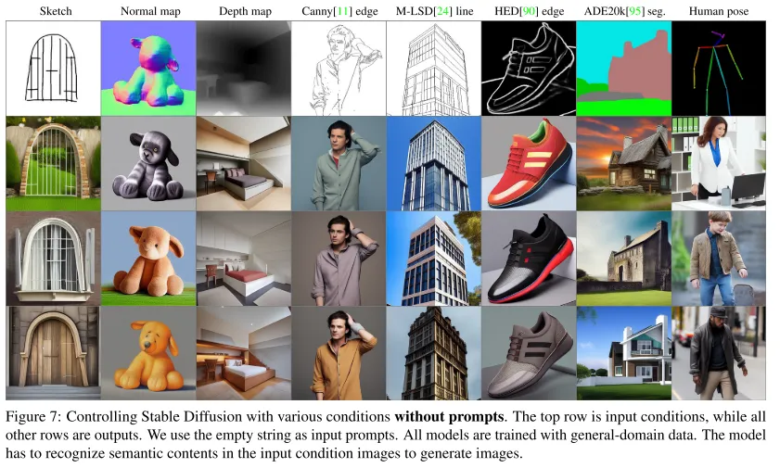
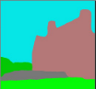
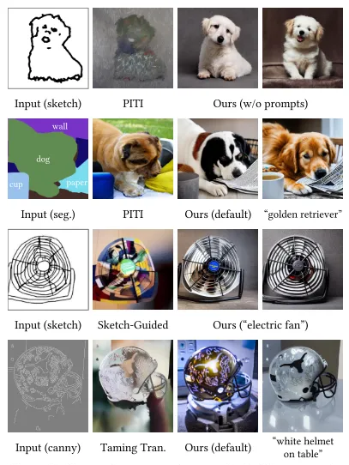
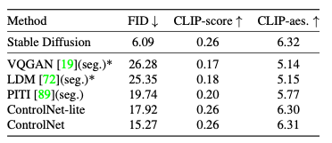
Evaluation & Conclusion
backbone
: GLIDE
Pros
Adds spatial conditioning(image) for fine-grained image generation
Utilizes existing models, reducing computation;
requires 23% more GPU memory and 34% additional training time compared to SD optimization
Supports various conditioning formats
Cons
Compex architecture
Performance degrades when conditional datasets are limited
The trainable copy is not applied to the decoder, making the extent of conditional influence uncertain

Slide 9
Thank you for your attention.!!!
QnA

